Slide 1
Chapter 6 – Architectural Design
CS 425 October 24, 2024
Note: These are a modified version of Chapter 6 slides available from the author’s site http://iansommerville.com/software-engineering-book/
Chapter 6 Architectural Design

Slide 2
Topics covered
Architectural design decisions
Architectural views
Architectural patterns (styles)
Application architectures
Chapter 6 Architectural Design

Slide 3
Architectural design
Architectural design is concerned with understanding how a software system should be organized and how to design the overall structure of that system
Architectural design is the critical link between design and requirements engineering, as it identifies the main structural components in a system and the relationships between them
The output of the architectural design process is an architectural model that describes how the system is organized as a set of communicating components
Chapter 6 Architectural Design

Slide 4
Agility and architecture
It is generally accepted that an early stage of agile processes is to design an overall systems architecture
Refactoring the system architecture is usually expensive because it affects so many components in the system
Chapter 6 Architectural Design

Slide 5
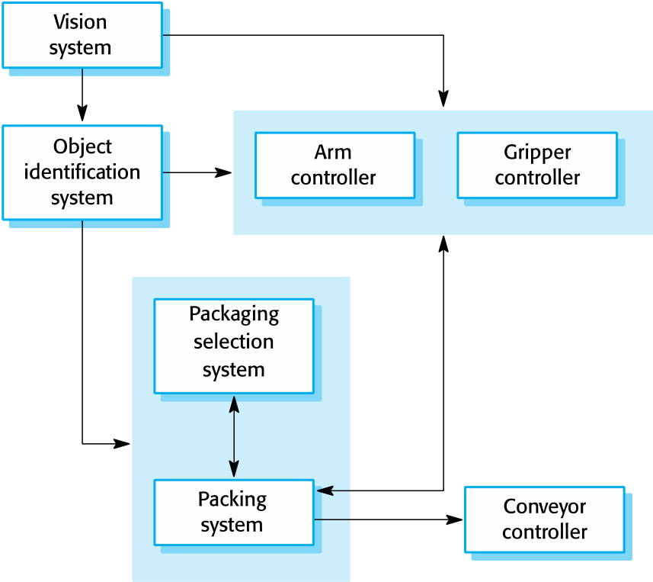
The architecture of a packing robot control system
Chapter 6 Architectural Design

Slide 6
Architectural abstraction
Architecture in the small is concerned with the architecture of individual programs. At this level, we are concerned with the way that an individual program is decomposed into components.
Architecture in the large is concerned with the architecture of complex enterprise systems that include other systems, programs, and program components. These enterprise systems are distributed over different computers, which may be owned and managed by different companies.
Chapter 6 Architectural Design

Slide 7
Advantages of explicit architecture
Stakeholder communication
Architecture may be used as a focus of discussion by system stakeholders
System analysis
Means that analysis of whether the system can meet its non-functional requirements is possible.
Large-scale reuse
The architecture may be reusable across a range of systems
Product-line architectures may be developed
Chapter 6 Architectural Design

Slide 8
Architectural representations
Simple, informal block diagrams showing entities and relationships are the most frequently used method for documenting software architectures
Very abstract - they do not show the nature of component relationships nor the externally visible properties of the sub-systems
However, useful for communication with stakeholders and for project planning
Chapter 6 Architectural Design

Slide 9
Use of architectural models
As a way of facilitating discussion about the system design
A high-level architectural view of a system is useful for communication with system stakeholders and project planning because it is not cluttered with detail. Stakeholders can relate to it and understand an abstract view of the system. They can then discuss the system as a whole without being confused by detail.
As a way of documenting an architecture that has been designed
The aim here is to produce a complete system model that shows the different components in a system, their interfaces and their connections.
Chapter 6 Architectural Design

Slide 10
Architectural design decisions
Chapter 6 Architectural Design

Slide 11
Architectural design decisions
Architectural design is a creative process so the process differs depending on the type of system being developed
However, a number of common decisions span all design processes and these decisions affect the non-functional characteristics of the system
Chapter 6 Architectural Design

Slide 12
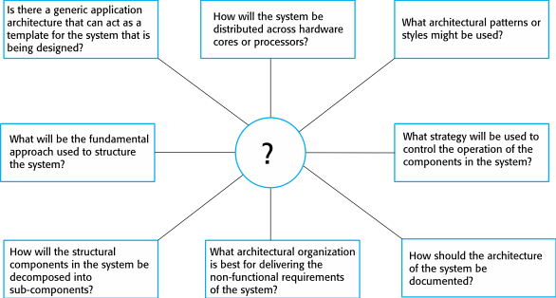
Architectural design decisions
Chapter 6 Architectural Design

Slide 13
Architecture reuse
Systems in the same domain often have similar architectures that reflect domain concepts
Application product lines are built around a core architecture with variants that satisfy particular customer requirements
The architecture of a system may be designed around one of more architectural patterns or ‘styles’.
These capture the essence of an architecture and can be instantiated in different ways
Chapter 6 Architectural Design

Slide 14
Architecture and system characteristics
Performance
Localize critical operations and minimize communications. Use large rather than fine-grain components.
Security
Use a layered architecture with critical assets in the inner layers
Safety
Localize safety-critical features in a small number of sub-systems
Availability
Include redundant components and mechanisms for fault tolerance
Maintainability
Use fine-grain, replaceable components
Chapter 6 Architectural Design

Slide 15
Architectural views
Chapter 6 Architectural Design

Slide 16
Architectural views
What views or perspectives are useful when designing and documenting a system’s architecture?
What notations should be used for describing architectural models?
Each architectural model only shows one view or perspective of the system
It might show how a system is decomposed into modules, how the run-time processes interact or the different ways in which system components are distributed across a network. For both design and documentation, you usually need to present multiple views of the software architecture.
Chapter 6 Architectural Design

Slide 17
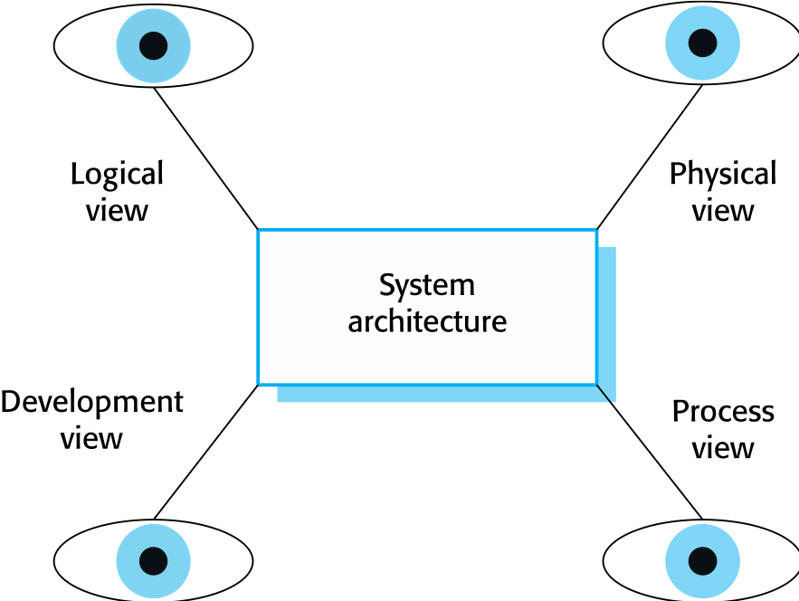
Architectural views
Chapter 6 Architectural Design

Slide 18
4 + 1 view model of software architecture
A logical view, which shows the key abstractions in the system as objects or object classes
A process view, which shows how, at run-time, the system is composed of interacting processes
A development (implementation) view, which shows how the software is decomposed for development
A physical (deployment) view, which shows the system hardware and how software components are distributed across the processors in the system
Related using a use case view (+1)
Chapter 6 Architectural Design

Slide 19
Architecture [Arlow and Neustadt, 2005]
The system architecture is “the organizational structure of the system, including its decomposition into parts, their connectivity, interaction, mechanisms and the guiding principles that inform the design of a system.” [Rumbaugh 1998]
There is a typical “4+1 views” architecture of a system defined by UML:
Logical view, captures the vocabulary of the problem domain using classes and objects
Process view, depicts the threads and processes of the system as active classes
Implementation view, shows the physical code base of the system in terms of components
Deployment view, models the physical deployment of components onto computational nodes
Use case view, captures the requirements of the system using a set of use cases. This is the view “+1” to which all other views connect.

Slide 20
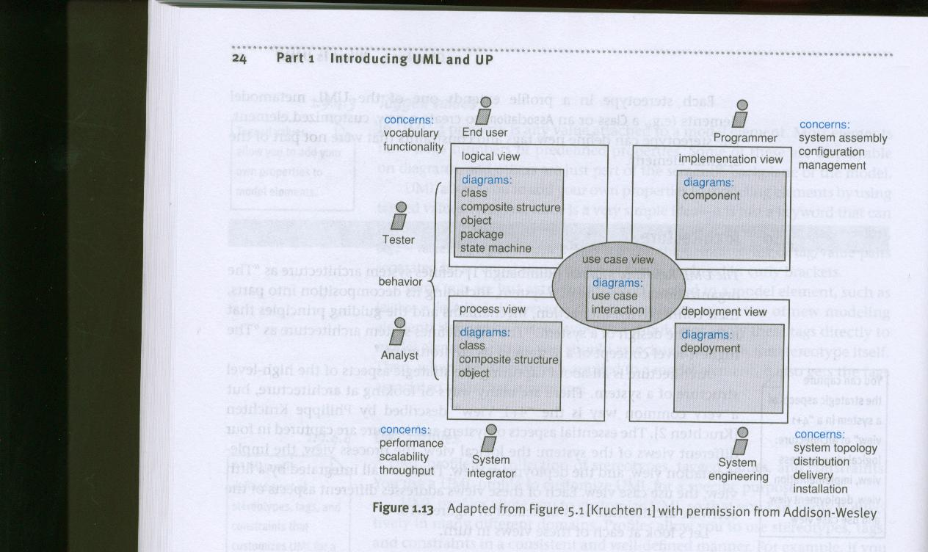
Architecture [Arlow and Neustadt, 2005]
The “4 +1 views” architecture, Fig. 1.13 [Arlow & Neustadt 2005]

Slide 21
Representing architectural views
Some people argue that the Unified Modeling Language (UML) is an appropriate notation for describing and documenting system architectures
Sommerville disagrees with this as he does not think that the UML includes abstractions appropriate for high-level system description
Architectural description languages (ADLs) have been developed but are not widely used
Chapter 6 Architectural Design

Slide 22
Architectural patterns
Chapter 6 Architectural Design

Slide 23
Architectural patterns
Patterns (styles) are a means of representing, sharing and reusing knowledge
An architectural pattern is a stylized description of good design practice, which has been tried and tested in different environments
Patterns should include information about when they are and when the are not useful
Patterns may be represented using tabular and graphical descriptions
Chapter 6 Architectural Design

Slide 24
The Model-View-Controller (MVC) pattern
Name | MVC (Model-View-Controller)
Description | Separates presentation and interaction from the system data. The system is structured into three logical components that interact with each other. The Model component manages the system data and associated operations on that data. The View component defines and manages how the data is presented to the user. The Controller component manages user interaction (e.g., key presses, mouse clicks, etc.) and passes these interactions to the View and the Model. See Figure 6.3.
Example | Figure 6.4 shows the architecture of a web-based application system organized using the MVC pattern.
When used | Used when there are multiple ways to view and interact with data. Also used when the future requirements for interaction and presentation of data are unknown.
Advantages | Allows the data to change independently of its representation and vice versa. Supports presentation of the same data in different ways with changes made in one representation shown in all of them.
Disadvantages | Can involve additional code and code complexity when the data model and interactions are simple.
Chapter 6 Architectural Design

Slide 25
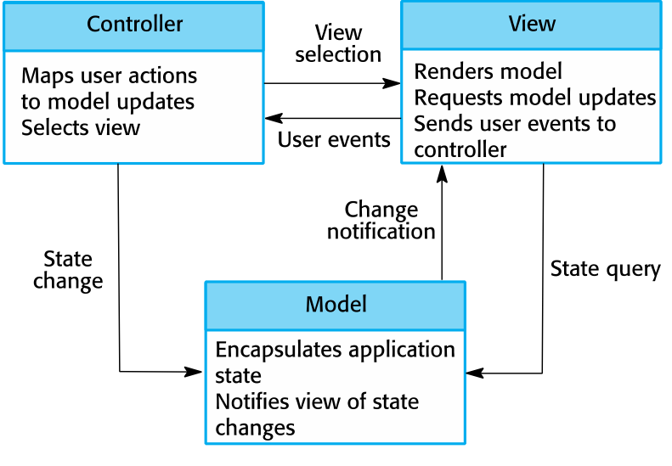
The organization of the Model-View-Controller
Chapter 6 Architectural Design

Slide 26
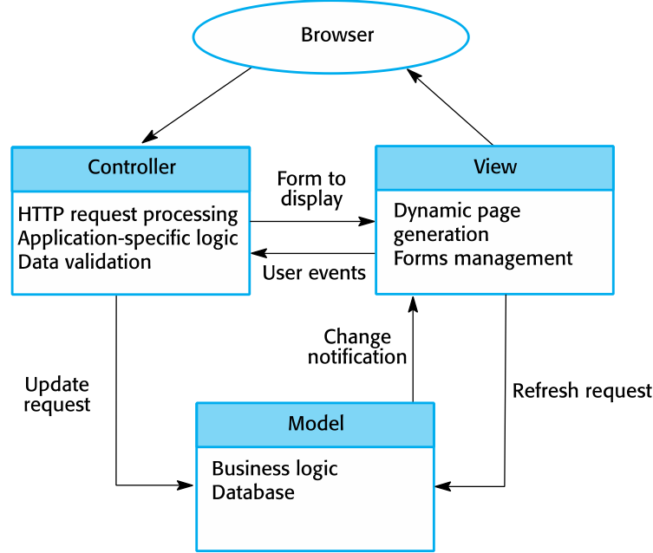
Web application architecture using the MVC pattern
Chapter 6 Architectural Design

Slide 27
Layered architecture
Used to model the interfacing of sub-systems
Organizes the system into a set of layers (or abstract machines) each of which provide a set of services
Supports the incremental development of sub-systems in different layers. When a layer interface changes, only the adjacent layer is affected.
However, it is often artificial to structure systems in this way
Chapter 6 Architectural Design

Slide 28
The Layered architecture pattern
Name | Layered architecture
Description | Organizes the system into layers with related functionality associated with each layer. A layer provides services to the layer above it so the lowest-level layers represent core services that are likely to be used throughout the system. See Figure 6.6.
Example | A layered model of a system for sharing copyright documents held in different libraries, as shown in Figure 6.7.
When used | Used when building new facilities on top of existing systems; when the development is spread across several teams with each team responsibility for a layer of functionality; when there is a requirement for multi-level security.
Advantages | Allows replacement of entire layers so long as the interface is maintained. Redundant facilities (e.g., authentication) can be provided in each layer to increase the dependability of the system.
Disadvantages | In practice, providing a clean separation between layers is often difficult and a high-level layer may have to interact directly with lower-level layers rather than through the layer immediately below it. Performance can be a problem because of multiple levels of interpretation of a service request as it is processed at each layer.
Chapter 6 Architectural Design

Slide 29
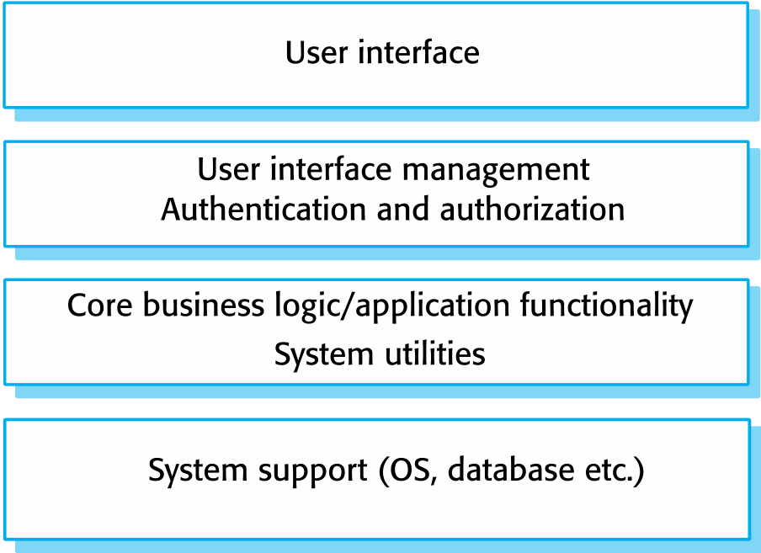
A generic layered architecture
Chapter 6 Architectural Design

Slide 30
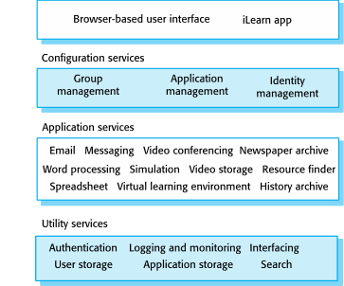
The architecture of the iLearn system
Chapter 6 Architectural Design

Slide 31
Repository architecture
Sub-systems must exchange data. This may be done in two ways:
Shared data is held in a central database or repository and may be accessed by all sub-systems;
Each sub-system maintains its own database and passes data explicitly to other sub-systems.
When large amounts of data are to be shared, the repository model of sharing is most commonly used as this is an efficient data sharing mechanism
Chapter 6 Architectural Design

Slide 32
The Repository pattern
Name | Repository
Description | All data in a system is managed in a central repository that is accessible to all system components. Components do not interact directly, only through the repository.
Example | Figure 6.9 is an example of an IDE where the components use a repository of system design information. Each software tool generates information which is then available for use by other tools.
When used | You should use this pattern when you have a system in which large volumes of information are generated that has to be stored for a long time. You may also use it in data-driven systems where the inclusion of data in the repository triggers an action or tool.
Advantages | Components can be independent—they do not need to know of the existence of other components. Changes made by one component can be propagated to all components. All data can be managed consistently (e.g., backups done at the same time) as it is all in one place.
Disadvantages | The repository is a single point of failure so problems in the repository affect the whole system. May be inefficiencies in organizing all communication through the repository. Distributing the repository across several computers may be difficult.
Chapter 6 Architectural Design

Slide 33
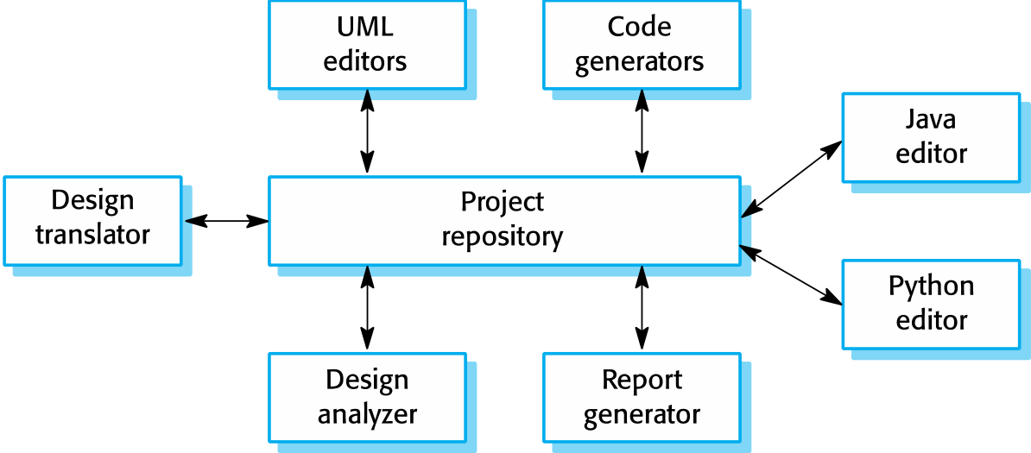
A repository architecture for an IDE
Chapter 6 Architectural Design

Slide 34
Client-server architecture
Distributed system model which shows how data and processing is distributed across a range of components
Can be implemented on a single computer
Set of stand-alone servers which provide specific services such as printing, data management, etc.
Set of clients which call on these services
Network which allows clients to access servers
Chapter 6 Architectural Design

Slide 35
The Client–server pattern
Name | Client-server
Description | In a client–server architecture, the functionality of the system is organized into services, with each service delivered from a separate server. Clients are users of these services and access servers to make use of them.
Example | Figure 6.11 is an example of a film and video/DVD library organized as a client–server system.
When used | Used when data in a shared database has to be accessed from a range of locations. Because servers can be replicated, may also be used when the load on a system is variable.
Advantages | The principal advantage of this model is that servers can be distributed across a network. General functionality (e.g., a printing service) can be available to all clients and does not need to be implemented by all services.
Disadvantages | Each service is a single point of failure so susceptible to denial of service attacks or server failure. Performance may be unpredictable because it depends on the network as well as the system. May be management problems if servers are owned by different organizations.
Chapter 6 Architectural Design

Slide 36
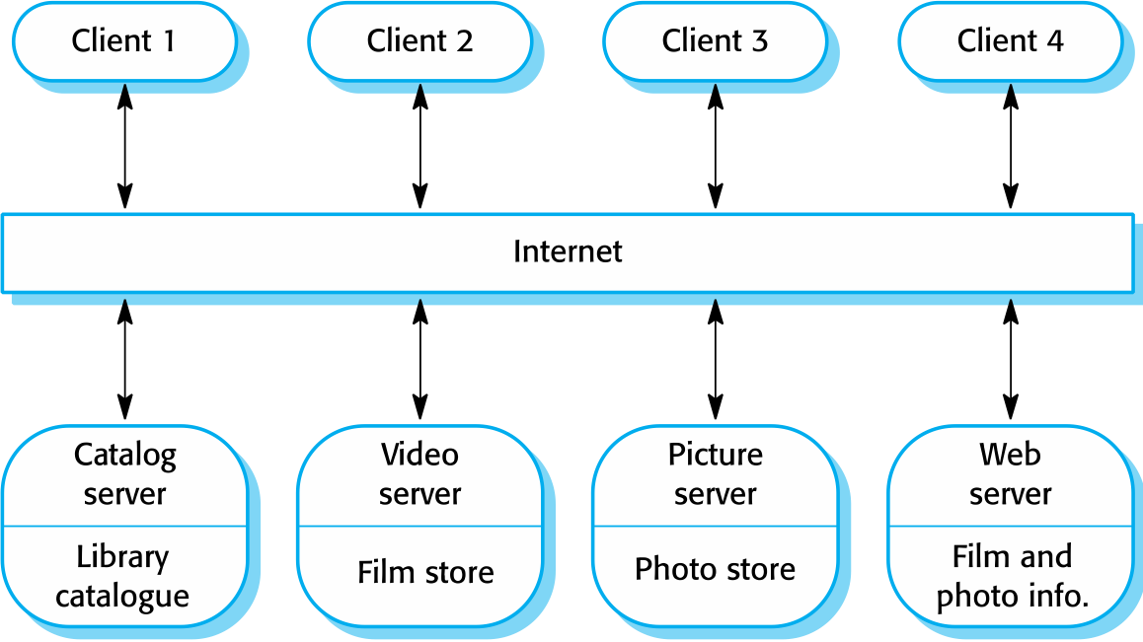
A client–server architecture for a film library
Chapter 6 Architectural Design

Slide 37
Pipe and filter architecture
Functional transformations process their inputs to produce outputs
May be referred to as a pipe and filter model (as in UNIX shell)
Variants of this approach are very common. When transformations are sequential, this is a batch sequential model which is extensively used in data processing systems
Not really suitable for interactive systems
Chapter 6 Architectural Design

Slide 38
The pipe and filter pattern
Name | Pipe and filter
Description | The processing of the data in a system is organized so that each processing component (filter) is discrete and carries out one type of data transformation. The data flows (as in a pipe) from one component to another for processing.
Example | Figure 6.13 is an example of a pipe and filter system used for processing invoices.
When used | Commonly used in data processing applications (both batch- and transaction-based) where inputs are processed in separate stages to generate related outputs.
Advantages | Easy to understand and supports transformation reuse. Workflow style matches the structure of many business processes. Evolution by adding transformations is straightforward. Can be implemented as either a sequential or concurrent system.
Disadvantages | The format for data transfer has to be agreed upon between communicating transformations. Each transformation must parse its input and un-parse its output to the agreed form. This increases system overhead and may mean that it is impossible to reuse functional transformations that use incompatible data structures.
Chapter 6 Architectural Design

Slide 39
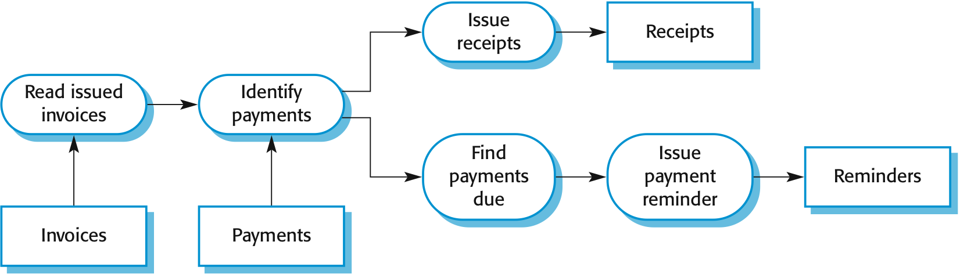
An example of the pipe and filter architecture used in a payments system
Chapter 6 Architectural Design

Slide 40
Application architectures
Chapter 6 Architectural Design

Slide 41
Application architectures
Application systems are designed to meet an organizational need
As businesses have much in common, their application systems also tend to have a common architecture that reflects the application requirements
A generic application architecture is an architecture for a type of software system that may be configured and adapted to create a system that meets specific requirements
Chapter 6 Architectural Design

Slide 42
Use of application architectures
As a starting point for architectural design
As a design checklist
As a way of organizing the work of the development team
As a means of assessing components for reuse
As a vocabulary for talking about application types
Chapter 6 Architectural Design

Slide 43
Examples of application types
Data processing applications
Data driven applications that process data in batches without explicit user intervention during the processing
Transaction processing applications
Data-centered applications that process user requests and update information in a system database
Event processing systems
Applications where system actions depend on interpreting events from the system’s environment
Language processing systems
Applications where the users’ intentions are specified in a formal language that is processed and interpreted by the system
Chapter 6 Architectural Design

Slide 44
Transaction processing systems
Process user requests for information from a database or requests to update the database
From a user perspective a transaction is:
Any coherent sequence of operations that satisfies a goal
For example - find the times of flights from London to Paris
Users make asynchronous requests for service which are then processed by a transaction manager
Chapter 6 Architectural Design

Slide 45
The structure of transaction processing applications
Chapter 6 Architectural Design

Slide 46
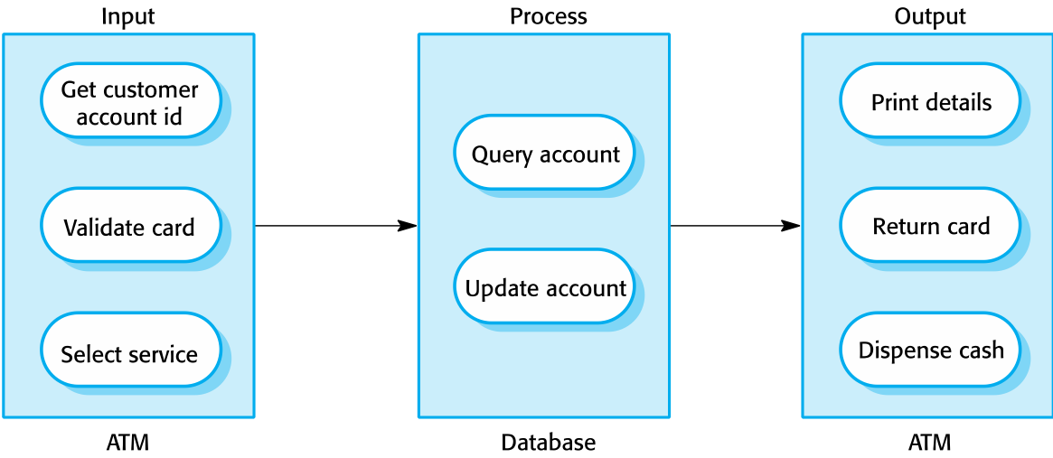
The software architecture of an ATM system
Chapter 6 Architectural Design

Slide 47
Information systems architecture
Information systems have a generic architecture that can be organized as a layered architecture
These are transaction-based systems as interaction with these systems generally involves database transactions
Layers include:
The user interface
User communications
Information retrieval
System database
Chapter 6 Architectural Design

Slide 48
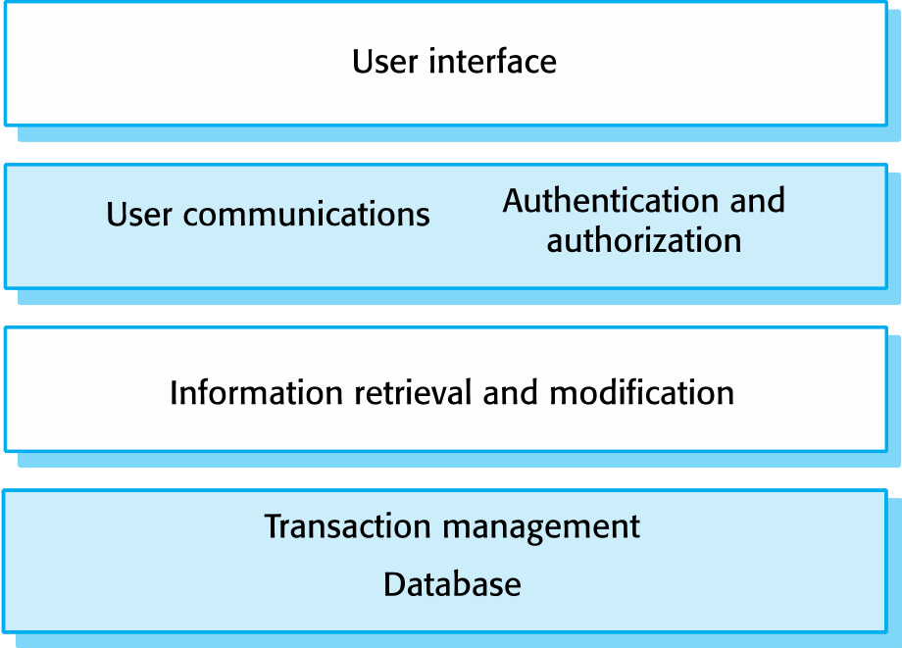
Layered information system architecture
Chapter 6 Architectural Design

Slide 49
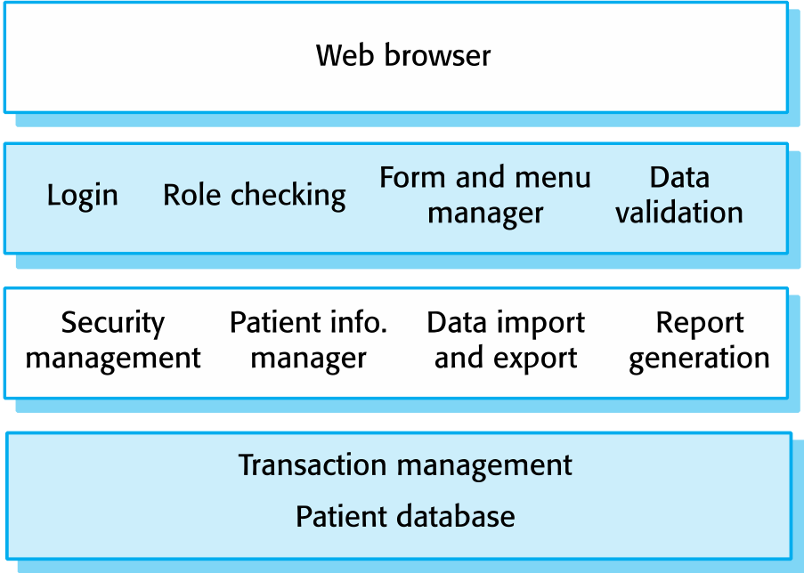
The architecture of the Mentcare system
Chapter 6 Architectural Design

Slide 50
Key points
A software architecture is a description of how a software system is organized
Architectural design decisions include decisions on the type of application, the distribution of the system, the architectural styles to be used
Architectures may be documented from several different perspectives or views such as a conceptual view, a logical view, a process view, and a development view
Architectural patterns (styles) are a means of reusing knowledge about generic system architectures. They describe the architecture, explain when it may be used and describe its advantages and disadvantages.
Chapter 6 Architectural Design

Slide 51
Key points
Models of application systems architectures help us understand and compare applications, validate application system designs and assess large-scale components for reuse
Transaction processing systems are interactive systems that allow information in a database to be remotely accessed and modified by a number of users
Chapter 6 Architectural Design

